Slide 1
First Lecture on Introductory Lisp
Yun Peng

Slide 2
Why Lisp?
Because it’s the most widely used AI programming language
Because AI researchers and theoreticians like using it
Because it’s good for writing production software (Graham article)
Because it’s got lots of features other languages don’t
Because you can write new programs and extend old programs really, really quickly in Lisp

Slide 3
Lisp stands for “LISt Process”
  Invented by John McCarthy (1958)
  Simple data structure (atoms and lists)
  Heavy use of recursion
  Interpretive language
Variations
  Frantz Lisp (80’s)
  Common Lisp (de facto industrial standard)
Common Lisp at gl.umbc.edu and sunserver1.csee.umbc.edu
  command line: clisp
  main site: http://clisp.sourceforge.net/
  help site: http://www.apl.jhu.edu/~hall/lisp.html
  tutorial site: http://grimpeur.tamu.edu/~colin/lp/node10.html

Slide 4
Valid objects (S-expressions)
Atoms:
numbers: (real 1.0, integer 1)
symbols: a consecutive sequence of characters (no space)
e.g., a, x, price-of-beef.
two special symbols: T and NIL for logical true and false.
strings: a sequence of characters bounded by double quotes
e.g., "this is red".
(Note: LISP is case insensitive)
Lists: a list of atoms and/or lists, bounded by "(" and ")“,
e.g., (a b c), (a (b c))
top elements of a list
example: top elements of list (a b c) are a, b, and c
top elements of list (a (b c)) are a and (b c)
nil: empty list, same as ().

Slide 5
2. Function calls
  also a list
  use prefix notation: (function-name arg1 ... argn)
  returns function value for the given list of arguments
  functions are either provided by Lisp function library or defined by the user.
  Examples:
>(+ 1 3 5)
9
>(/ 3 5)
3/5
>(/ 3.0 5)
0.59999999999999998
>(sqrt 4)
2

Slide 6
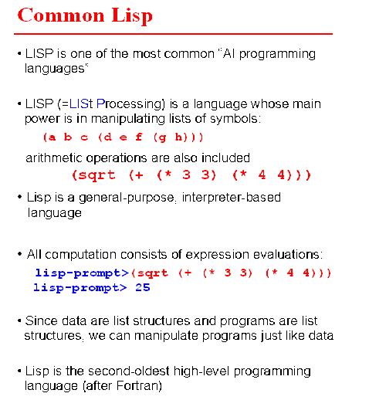
Sqrt
+
*

Slide 7
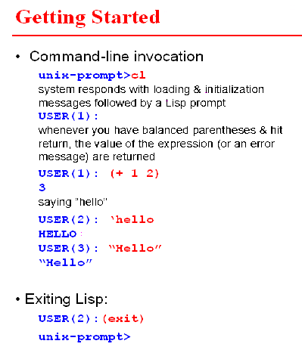
exit
quote = `

Slide 8
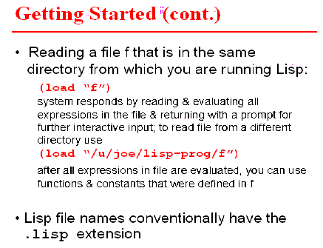
load

Slide 9
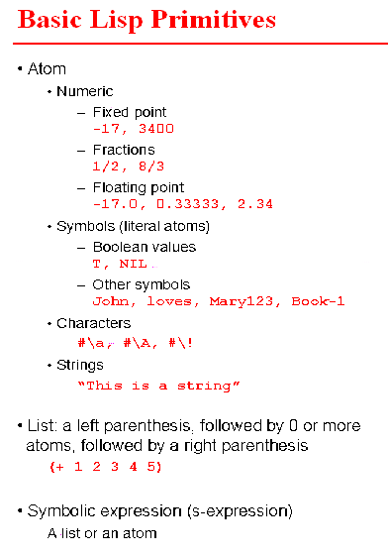
Atoms
numeric
fractions
floating point
literal atoms
Boolean values
other symbols
strings

Slide 10
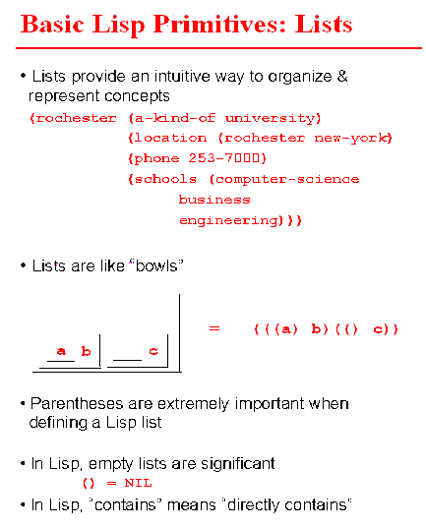
Lists
NIL = ()

Slide 11
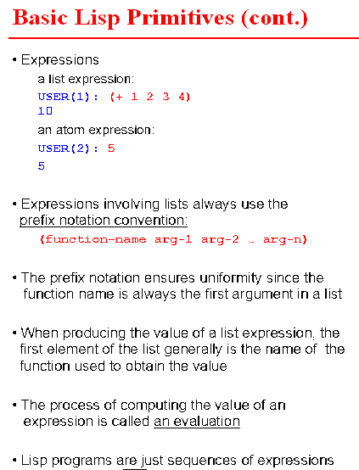
Function calls
evaluation of functions

Slide 12
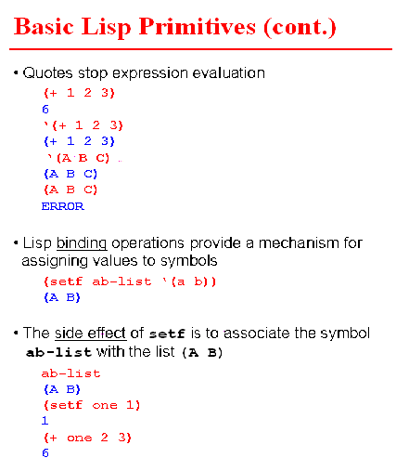
setf more general than setq
binding

Slide 13
3. Evaluation of S-expression
1) Evaluate an atom.
  numerical and string atoms evaluate to themselves;
  symbols evaluate to their values if they are assigned values,
  return Error, otherwise;
  the values of T and NIL are themselves.
2) Evaluate a list - evaluate every top element of the list as follows,
unless explicitly forbidden:
  the first element is always a function name;
  evaluating it means to call the function body;
  each of the rest elements will then be evaluated, and their values
  returned as the arguments for the function.
  Examples
>(+ (/ 3 5) 4)
23/5
>(+ (sqrt 4) 4.0)
6.0
>(sqrt x)
Error: The variable
X is unbound.

Slide 14
3) To assign a value to a symbol (setq, set, setf)
  setq is a special form of function (with two arguments);
  the first argument is a symbol which will not be evaluated;
  the second argument is a S-expression, which will be evaluated;
  the value of the second argument is assigned to be the value of
  the first argument
  to forbid evaluation of a symbol (quote or ‘)
>(setq x 3.0)
3.0
>x
3.0
>(setq y x)
3.0
; the value of x is assigned as
the value of y
>y
3.0
>(+ x y)
6.0

Slide 15
>(quote x)
x
>'x
x
>(setq z 'x)
x
  . to force an evaluation, using function "eval"
Two more assignment functions:
(set x y) ; assign the value of y to the value of x. x is evaluated
; first and whose value must be a symbol
; "setq" is a combination of "set" and "quote"
(setf x y) ; similar to but more general than "setq" in that x can be
; something other than a symbol.
>(+ x z)
Error: X is not of type NUMBER ...
>(+ x (eval z))
6.0
eval

Slide 16
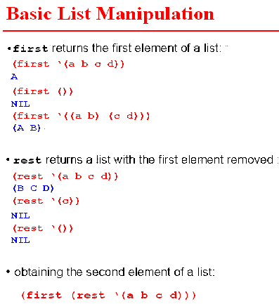
first
rest
function nesting

Slide 17
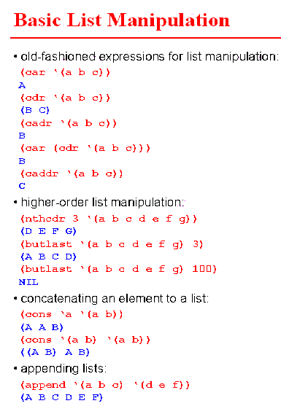
car
cdr
cadr
caddr
nthcdr
butlast
cons
append

Slide 18
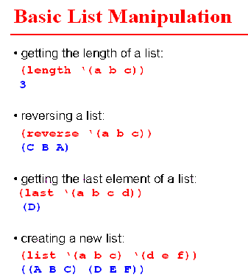
length
reverse
last
list

Slide 19
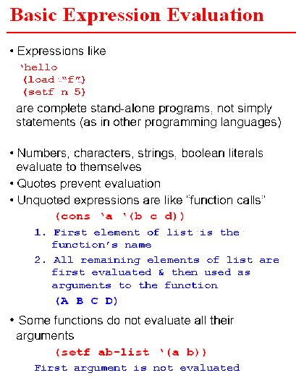
Basic expression evaluation

Slide 20
2) Predicates (a special function which returns NIL if the predicate
is false, T or anything other than NIL, otherwise)
=, >, <, >=, <= for numerical values;
equal, eq, for others (symbols, lists, etc.)
tests if x is a atom
tests if x is a list
also numberp, symbolp, null
predicates
>(< x y)
NIL
>(= x y)
T
>(equal ‘x ‘y)
NIL
>(equal ‘a (car L))
T
>(atom x)
T
>(atom L)
NIL
>(atom (car L))
T
>(listp x)
NIL
>(listp L)
T
>(numberp ‘x)
NIL
>(numberp x)
T
>(symbolp ‘x)
T
>(symbolp x)
NIL

Slide 21
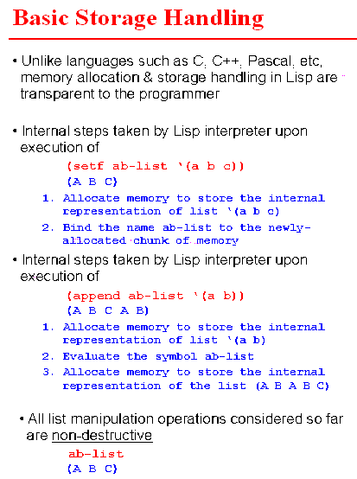
Basic storage handling

Slide 22
>(null L)
NIL
>(null NIL)
T
>(null x)
NIL
3) Set operations ( a list can be viewed as a set whose members
are the top elements of the list)
>(member 'b L) ; test if symbol b is a member (a top element) of L
(B C) ; if yes, returns the sublist of L starting at the
; first occurrence of symbol b
>(member ‘b (cons 'b L))
(B A B C)
>(member x L)
NIL ; if no, returns NIL
>(union L1 L2) ; returns the union of the two lists
>(intersection L1 L2) ; returns the intersection of the two lists
>(set-difference L1 L2) ; returns the difference of the two lists
Set operations

Slide 23
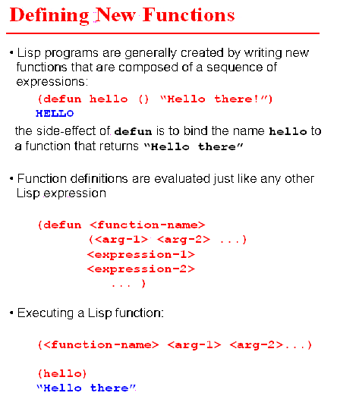
defun

Slide 24
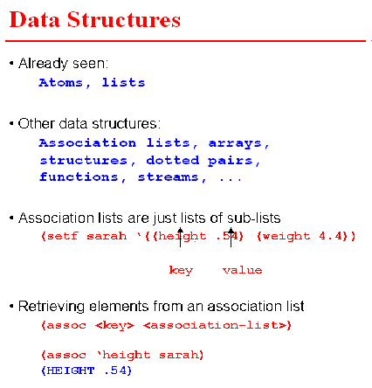
Data structures
assoc

Slide 25
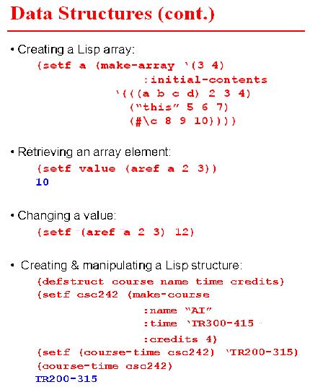
make-array
aref
defstruct

Slide 26
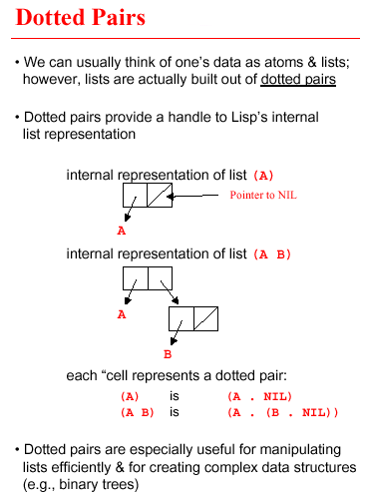
Dotted pairs

Slide 27
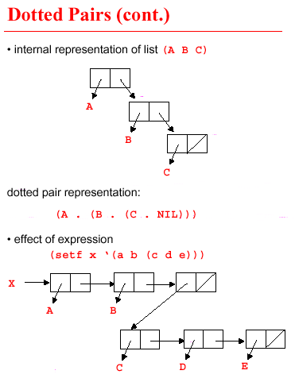
Dotted pairs

Slide 28
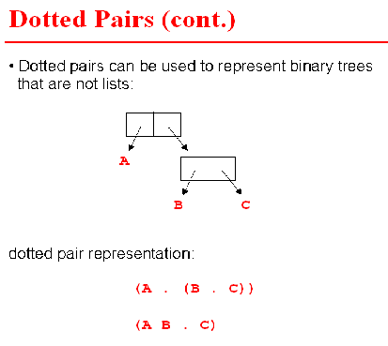

Slide 29
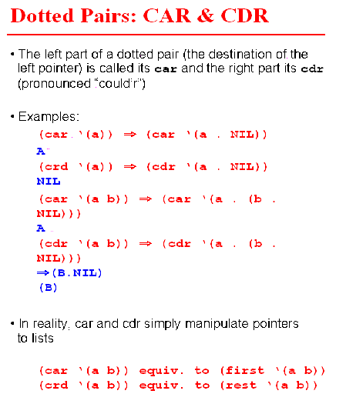

Slide 30
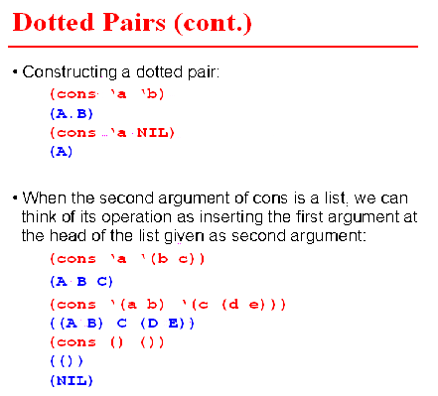

Slide 31
conditional
4) Conditional
  >(cond (<test-1> <action-1>)
  .
  .
  .
  (<test-k> <action-k>))
  each (<test-i> <action-i>) is called a clause;
  if test-i (start with i=1) returns T (or anything other than NIL),
  this function returns the value of action-i;
  else, go to the next clause;
  usually, the last test is T, which always holds, meaning otherwise.
  cond can be nested (action-i may contain (cond ...))

Slide 32
Now, having basic functions, defun and cond we can define any Lisp function. Examples.
5. Define functions (heavy use of recursive definitions)
(defun func-name (arg-1 ... Arg-n) func-body)
examples:
(defun member (x L)
(cond ((null L) nil) ; base case 1: L is empty
((equal x (car L)) L) ; base case 2: x=first(L)
(t (member x (cdr L))) ; recursion: test if x is in rest(L)
))
(defun intersection (L1 L2)
(cond ((null L1) nil)
((null L2) nil)
((member (car L1) L2)
(cons (car L1) (intersection (cdr L1) L2)))
(t (intersection (cdr L1) L2))
))
Example: (intersection '(a b c) '(b a b c)) returns (a b c)
(intersection '(b a b c) '(a b c)) returns (b a b c)
member
intersection

Slide 33
(defun set-difference (L1 L2)
(cond ((null L1) nil)
((null L2) L1)
((not (member (car L1) L2))
(cons (car L1) (set-difference (cdr L1) L2)))
(t (set-difference (cdr L1) L2))
))
Define functions iteratively.
(dolist (x L result) body)
  for each top level element x in L, do body(x);
  x is not equal to an element of L in each iteration, but rather x takes an element of L as its value;
(dotimes (count n result) body)
; do body n times. count starts with 0, ends with n-1
Note: result is optional, to be used to hold the computing result.
If result is given, the function will return the value of result,
returns NIL, otherwise. (may change global variables as side effects.)
dolist
dotimes

Slide 34
Various definitions of SUM
dolist
(defun sum1 (L)
(setq y 0)
(dolist (x L y)
(setq y (+ y x))))
(defun sum2 (L)
(setq y 0)
(dolist (x L y)
(setq y (+ y (eval x)))))
(defun sum3 (L)
(setq y 0)
(dotimes
(count (length L) y)
(setq y (+ y (nth count L)))
))
defun sum4 (L)
(setq y 0)
(dotimes
(count (length L) y)
(setq y
(+ y (eval (nth count L))))
))
>(setq L1 '(1 2 3))
(1 2 3)
dotimes
>(sum1 L1)
6

Slide 35
>(setq L1 '(1 2 3))
(1 2 3)
>(setq L2 '(a b c))
(A B C)
>(dotimes (count 3)
(set (nth count L2)
(nth count L1)))
NIL
>a
1
>(sum1 L1)
6
>(sum1 L2)
Error: …
>(sum2 L2)
6
>(sum3 L1)
6
>(sum3 L2)
Error: …
>(sum4 L2)
6

Slide 36
Other functions in LISP library
zerop
1) Predicates:zerop, plusp, evenp, oddp, integerp, floatp
2) Logical connector: and, or, not
3) Rounding: floor,ceiling, truncate, round
4) Others:
max, min, abs, sqrt, 1+ (add 1), 1- (minus 1)
(exp number) (base-e exponential)
(expt Base-number Power-Number)
(log number & Optional base-number)
(isqrt number) Returns the greater integer less than or equal to
the exact positive square-root of the number.
(signum number) Returns -1, zero, or 1 according if the number
is negative, zero, or positive.
plusp
evenp
oddp
integerp
floor
ceiling
truncate
floatp
round
exp
expt

Slide 37
Property lists:
>(setq L2 '(a b c))
(A B C)
1) Assign/access properties (attribute-value pairs) of a symbol
To assign a property: (setf (get object attribute) value)
To obtain a property: (get object attribute)
Example:
>(setf (get 'a 'heights) 8) ; cannot use "setq" here
8
>(get 'a 'height)
8
>(setf (get (cadr L2) 'height) 9)
9
>(get 'b 'height)
9
SETF with GET

Slide 38
SETF and associative list
Associative list: attach a list of properties to a symbol,
each property can be retrieved by key (property symbol)
  >(setf sarah '((height 6) (weight 100) (sex "F")))
  ((HEIGHT 6) (WEIGHT 100) (SEX "F"))
  >(assoc 'weights sarah)
  (WEIGHT 100)

Slide 39
mapcar
mapcar: (mapcar #’p-name L)
transform list L to another list by performing procedure p-name to
each top level element of L.
>(mapcar #’sqrt L1)
(1 1.4142135 1.7320508)
transforming more than one lists
(defun sq1 (x) (* x x))
define the function within mapcar (unnamed),
use lambda notation
>(mapcar #’sq1 L1)
(1 4 9)
>(mapcar #’set L2 L1)
(1 2 3)
>a
1
>(mapcar #'* L1 L1 L1)
(1 8 27)
>(mapcar #'(lambda (x)
(setq x (+ 1 (eval x)))) L2)
(2 3 4)
>a
2

Slide 40
PRINT and READ
input/output: print/read
on screen:
>(print (get 'a 'height))
8
8
>(print L2)
(A B C)
(A B C)
>(setq p (read))
10 ;typed on the screen
10
>p
10
with external file:
(with-open-file (<stream-name> <file-name> :direction :input or :output)
... )
internal variable name
external file name

Slide 41
>(with-open-file (data "in.dat" :direction :input) ; input file “in.dat” contains
(setq L3 nil) ; 1 2 3 4 5
(dotimes (count 5) (setq L3 (cons (read data) L3)))
)
NIL
>L3
(5 4 3 2 1)
>(with-open-file (result "out.dat" :direction :output)
(dotimes (count 5) (print (+ 1 (nth count L3)) result)))
NIL
;an external file "out.dat" is created and contains
6
5
4
3
2
with-open-file

Slide 42
NEW LISP Primitives
Some new primitive/functions
Access a list
first, second, ..., tenth ;extension of CAR,
;return the ith element
rest, last ; extension of CDR, return a list
Conditional
(if <test> body1 body2) ;do body1 if test is true, ;body2, otherwise
(when <test> body) ;do body when test is true
(unless <test> body) ;do body when test is false

Slide 43
LOADING, COMPILING AND EDITING
%clisp ; enter Common Lisp of CMU (on gl.UMBC.edu)
>(bye) or (quit)
or <ctrl>-D ; exit CLISP
(load "file-name") ; load in a file
(ed "file-name") ; enter vi editor
(compile-file "file-name") ; the compiled version is in file-name.o
; then load in file-name.o
(compile 'func-name) ; compile a particular function
(time (func-name arg1 ... argn))
; print real and run time for executing func-name

Slide 44
Summary
Basic Lisp primitives
Manipulating lists in Lisp
Expressions in Lisp & their evaluation
Defining simple functions
Basic Lisp data structures
Dotted pairs

Slide 45
Summary
FUNDAMENTAL FUNCTIONS TO REMEMBER
Atoms and lists
Functions and function calls
setq, setf, set, quote, eval,
math functions (+, -, *, /, max, min, exp, sqrt, …)
list operations: list, cons, car, cdr, length, nth, append, reverse
predicates (=, >, equal, eq, numberp, symbolp, …)
Defining functions
(defun func_name (arg_list) func_body)
dolist, dotimes, cond, if, when, unless, mapcar
Properties and associative lists: get, assoc
Input/output: print, read, with-open-file, load

